Slide 1
Test Security and Ethics
Kansas Assessment Program
Training Course
For Educators

Slide 2
Agenda
KSDE Test Security Plan
District Test Security Procedures
Roles and Responsibilities for DTC, BTC and/or Educator/Test Proctor
Reporting Testing Discrepancies and Potential Violations
Reporting Item Issues
Appropriate and Inappropriate Testing Practices
Monitor Visits
Test Security Agreement to Abide by Guidelines and Sign Off

Slide 3
Verification of Training
All district staff who administer a state assessment must provide verification of training by signing an agreement to abide by form and sign off on training.
District and building-level personnel include any staff member who administers a state assessment, including administrators, educators, para educators, or other appointed staff members.
Parent volunteers may not administer a state assessment.
Notes:
All educators must complete the training and sign off at least 2-4 weeks prior to the start of testing.

Slide 4
Verification
Any staff member who administers a state assessment must sign an agreement to adhere to test security and ethical testing practices.
Written verification is needed for the protection of each Teacher/Proctor and the district.
Notes:
Provide staff with an agreement to abide by sheet for them to sign along with a sign off that they have received this training. We will complete the sign off process at the end of our training.

Slide 5
Materials Needed
Prior to beginning the training, you will need to download or have access to the following materials from the KSDE or Kansas Assessment Program (KAP) website www.ksassessments.org:
2020–2021 Test Security and Ethics Fact Sheet
2020–2021 Appropriate Testing Practices Fact Sheet
Kansas State Test Security Guidelines
Notes:
Please download or provide the materials to district staff to assist with completion of the training.

Slide 6
Testing Window
TBD by buildings
Prior to beginning the training, you will need to download or have access to the following materials from the KAP website www.ksassessments.org
2020–2021 Kansas Assessment Program Overview (Testing Window Calendar)
Kansas Assessment Examiner’s Manual (KAEM)–Available January 4, 2020
Notes:
Please download or provide the materials to district staff to assist with completion of the training.

Slide 7
Kansas Assessment Examiner’s Manual
The Kansas Assessment Examiner’s Manual (KAEM) will be available the first week of January at www.ksassessments.org
Any staff member who administers or supports the administration of the state assessment must read the KAEM prior to administering the assessment.
Since this document is not available until January, you will need to build this into your training plans and do a careful review of the manual.
Notes:
Please download or provide the materials to district staff to assist with completion of the training.
Have staff: Highlight text that is important to them when administering a state assessment. Allow time for discussion of text in the document as you work through the training.

Slide 8
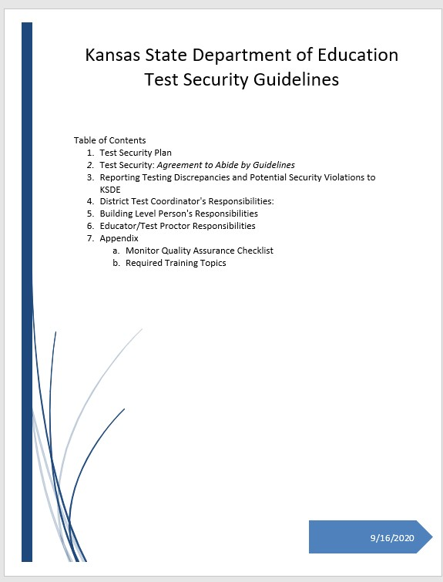
Kansas State Test Security Guidelines
Please take time now to read the Kansas State Department Test Security Guidelines.
This training will reference key points in the document that are critical for the understanding of staff who administer a state assessment.
Highlight text that is important to the role you serve when administering a state assessment.
Notes:
Have staff: Highlight text that is important to the role they serve when administering a state assessment. Allow time for discussion of text in the document as you work through the training.

Slide 9
KSDE Fact Sheets
Please take time now to read the following:
2020–2021 Test Security and Ethics Fact Sheet
Provides an overview of the KSDE test security plan.
Indicates where to access the roles and responsibilities for the DTC, BTC, and test administrators in test security.
Tells how to report testing discrepancies and potential security violations to KSDE.
2020–2021 Appropriate Testing Practices Fact Sheet
Describes acceptable practices for testing.
Describes unacceptable practices for testing.
Notes:
Take time to read and review the 2020-2021 Test Security and Ethics Fact Sheet and the 2020-2021 Appropriate Testing Practices Fact sheet now. This training will refer back to these documents.

Slide 10
Purpose
Test security is essential to obtain reliable and valid scores for accountability purposes.
Accordingly, the Kansas State Department of Education must take every step to assure the security and confidentiality of the state test materials.

Slide 11
Purpose
Everyone who is involved in student testing, communicates results, and/or receives testing information is responsible for test security.

Slide 12
Purpose
All Kansas assessment programs must abide by test security and ethical testing practices. These programs include the following:
Kansas assessment summative tests in English language arts (ELA), math, and science
Kansas assessment predictive interim assessments in ELA and math
Kansas English Language Proficiency Assessment (KELPA)
cPass® assessment
Dynamic Learning Maps® (DLM®) alternate assessments
*NOTE: Additional training modules are provided for staff administering DLM assessments.

Slide 13
District Test Coordinators Responsibilities
Oversee test security for the entire district.
Establish and implement test security and ethics procedures for the district.
Train district and building-level personnel before testing begins, including training regarding test security procedures, ethics of testing, and reporting/documentation of accommodations.
Refer to the KSDE Test Security Guidelines document for a complete list of responsibilities.
Notes:
As the DTC/BTC I am responsible for test security for our district/building. Careful consideration of district practices must be put in place to ensure that test security is maintained and ethical practices are followed. I have to document which individuals have received training, when the training was provided, and the way in which the training was provided; documentation must be kept at both the district and building level. Documentation must be made available for monitor visits should our district have one. Allow staff time to ask questions about your responsibilities.

Slide 14
DTC Responsibilities
As the DTC I must maintain a training log that verifies who was trained and when the training was completed.
The training log is required for a monitor visit and for validation that staff have received training in your district.
At the end of our training we will sign the appropriate forms to document training and agreement to abide by ethical practices and procedures.

Slide 15
Kite® Educator Portal
The DTC has access to and determines educator roles within the Educator Portal.
Usernames and passwords should NEVER be shared with anyone!
When you log into the Ed Portal, you will sign a security agreement.
If issues arise with access, contact your BTC or DTC to resolve.

Slide 16
Daily Access Code (DAC)
During testing, students must use a Daily Access Code to enter Kite Student Portal. This code is provided in Educator Portal and is not directly available to teachers and Test Proctors.
School district have the autonomy to choose the process of communication DAC. At Perry Lecompton, BTC will share DACs.

Slide 17
Personal Needs Profile (PNP)
Students may have accommodations during testing. These accommodations must be done routinely and are typically part of an IEP or 504 student plan.
Accommodations must be entered into Kite Educator Portal.
BTCs are responsible for ensuring student accommodation information is submitted into the Personal Needs Profile (PNP) in Educator Portal.
BTCs and the DTC must maintain documentation of any accommodations, including text-to-speech, that requires a deviation from the general assessment.

Slide 18
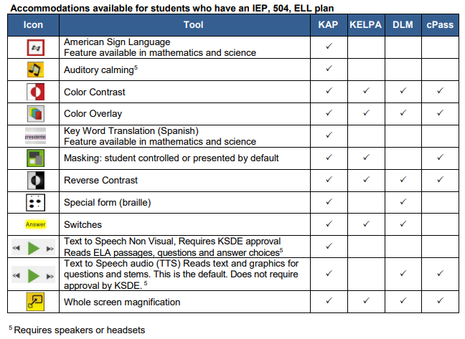
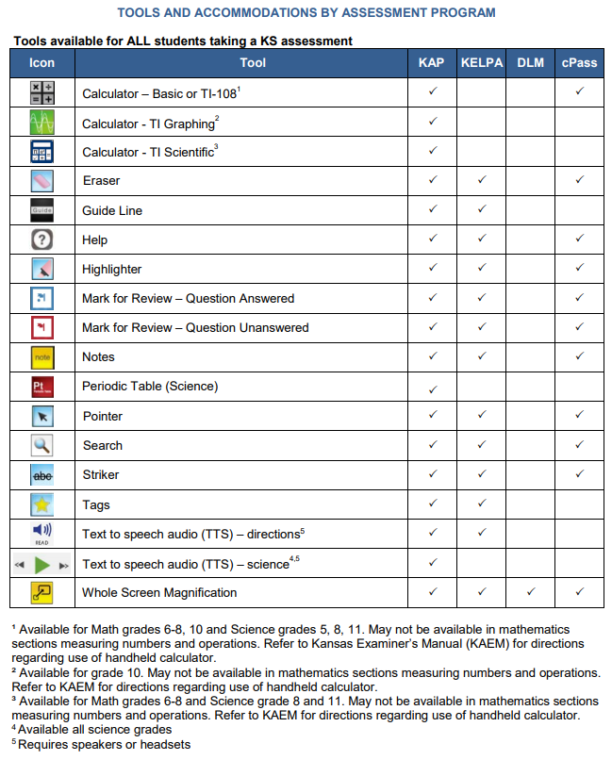
Kansas Accommodations by Program 2020–2021
An additional resource found on www.ksassessments.org and on the KSDE assessment page
Indicates the tools available for students in Kite Student Portal
Please review these tools so you are familiar with these options for students.

Slide 19
Personally identifiable information (PII), Reporting
Personally identifiable information (PII) is any data that could potentially identify a specific individual. Any information that can be used to distinguish one person from another and can be used for de-anonymizing anonymous data can be considered PII.
Reporting topics include the following:
Personally Identifiable Information (PII)
Testing Issues to Kite Service Desk
Testing Discrepancies and Potential Security Violations to KSDE
Data Used to Examine Potential Irregularities

Slide 20
Personally Identifiable Information (PII)
PII must NOT be conveyed when testing issues are reported.
The documentation for Kansas regarding allowable identifiers in an email specify that only the Student State ID number and no other identifying details should be provided in an email.

Slide 21
Reporting Testing Issues to Kite Service Desk
Please do not report any PII.
The documentation for Kansas regarding allowable identifiers in an email specify that only the student state ID number and no other identifying detail is to be used in email.
Do not include the student name, district, or school.

Slide 22
Contacting the Service Desk
When contacting the Service Desk
DO NOT send any PII for a student via email. This is a federal violation of the Family Education Rights and Privacy Act (FERPA). PII includes such information as a student’s name, building name, or district name.
DO send the student ID number, the test the students are taking (ELA, math, science, predictive interim, mini-test), and the error or concern you are reporting regarding the test taker.

Slide 23
Reporting Testing Discrepancies and Potential Security Violations to KSDE
It is the responsibility of the superintendent or their designee, on behalf of any and all school principals, to report in writing, all discrepancies in test material delivery, administration, and collection, as well as issues and concerns regarding potential violations of the Kansas State Department of Education’s test security procedures, to Julie Ewing, Assessment Coordinator, Kansas State Department of Education, 785-296-4349.

Slide 24
Reporting Testing Discrepancies and Potential Security Violations to KSDE
In consultation with staff from KSDE upon breach of security, appropriate consequences will be put in place at the district level.
Because each case is unique in nature, a variety of steps could take place, including, but not limited to, the following:
No action taken: discussion with KSDE indicated the breach was not severe enough in nature to warrant any action
KSDE action: written letter and/or phone call to superintendent, DTC stating concerns and processing of action steps
Retesting of students
Removal of Test Proctors from testing rooms
KSDE monitor visit follow-up the next testing year to check for validation that changes to inappropriate practices have been made

Slide 25
USD 343 Procedures for Reporting
IMMEDIATELY alert your BTC of any testing discrepancies or potential security violation.
Your BTC will notify Julie Ewing at KSDE as well as the DTC.

Slide 26
Reactivation Procedures
In rare instances, some students may not be able to complete a test session.
If a need to reactivate occurs, the teacher or proctor should contact the BTC. The BTC will need to document who, when and why the reactivation occurred. Be sure to have this information ready.

Slide 27
Appropriate Testing Practices Acceptable Practices (Fact Sheet)
Provide students with the opportunity to learn the content and vocabulary prior to testing by basing instruction on state standards and an aligned local curriculum.
Integrate teaching of test-taking skills with regular classroom instruction and assessment.
Ensure that students have had prior experience with the testing format. Use Kite Technology Practice tests. These are for the intended purpose of practicing technology and not content.
Use formative assessments to inform instruction prior to testing. Formative tools are available in the Kite interim system.

Slide 28
Appropriate Testing Practices Acceptable Practices (Fact Sheet)
Ensure that accommodations made on the state assessment are completed on all instructional assignments, as well as classroom, district, and standardized assessments.
Attend training and sign an agreement to abide by KSDE test security, ethics of testing, and regulations before local testing begins.
Follow test procedures outlined in the Kansas Assessment Examiner’s Manual and in the training received regarding security and ethical practices for testing.
Follow established district/building procedures for collecting and destroying testing materials, student notes, scratch paper, and drawings upon completion of each test session and the entire test.

Slide 29
Appropriate Testing Practices Acceptable Practices (Fact Sheet)
Remove or cover (with opaque material) bulletin board displays, charts and diagrams, and other instructional material that could give assistance or advantage during testing.
Monitor the testing environment actively by moving around the room; moving around the room encourages students to focus on their own work.
Verify the End/Review Screen upon completion of the test to ensure that all test items have been answered before a student exits the test.

Slide 30
Appropriate Testing Practices Unacceptable Practices (Fact Sheet)
Do not store or save on computers or personal storage devices any test items; test items may not be shared via email or other file sharing systems or reproduced by any means.
Do not review tests or analyze test items before, during, or after the assessment has been administered.
Follow test procedures outlined in the Kansas Assessment Examiner’s Manual and in the training received regarding security and ethical practices for testing.
Follow established district/building procedures for collecting and destroying testing materials, student notes, scratch paper, and drawings upon completion of each test session and the entire test.

Slide 31
Appropriate Testing Practices Unacceptable Practices (Fact Sheet)
Do not discuss any specific test items on the test with students or colleagues before, during, or after the administration of the assessment.
Do not construct answer keys so that an assessment could be scored locally.
Do not use actual or altered test items (clone, parallel) for practice or instruction.

Slide 32
Appropriate Testing Practices Unacceptable Practices (Fact Sheet)
Do not conduct comprehensive reviews or drills the day of the test or between testing sessions. Once testing has begun, all reviewing should cease. Curriculum may be taught but not for review for the specific purposes of the test.
Do not require students to show work or use scratch paper; scratch paper may not be graded and must be destroyed at the end of the test session.
Do not respond to questions during testing that would help the students understand the item, aid them in responding to an item, or advise/encourage them to edit or change a response.

Slide 33
Appropriate Testing Practices Unacceptable Practices (Fact Sheet)
Do not say or do anything that would let a student know whether an answer is correct or incorrect.
Do not coach or cue students in any way during test administration, including using gestures or facial expressions for guidance.
Do not ask students the way in which they arrived at an answer.
Do not tell students to redo a specific item or to review any specific part of the test once testing has begun.
Do not go back and review each item individually with the student; simply direct students to answer items that did not have a check mark to indicate that the item was answered.

Slide 34
Monitor Visit: Purpose
KSDE staff and the members of the Kansas Assessment Advisory Council visit about 10% of Kansas schools during test administration yearly for the purpose of monitoring test security.
A representative sample of districts across Kansas, across all state BOE regions, including both large and small districts, are selected for monitor visits every year in Kansas.

Slide 35
Monitor Visits
Two methods will be used to conduct monitor visits:
Schools/districts can volunteer to receive a monitor visit. A monitor team will be assigned to that district. The team will select the date they will conduct the visit based on the testing schedule provided by the school. The district will not be informed of the specific date selected.
Unannounced visits for a random sample of schools: schools will be chosen from the list of districts/schools that did not volunteer. The DTC will be alerted to potential visits and will share test schedules for the purpose of monitor visits.
Random sample collection includes consideration of board member districts, district size, rural/urban, previous violations, and previous monitor visits.

Slide 36
Monitor Checklist
Let’s look at and discuss the monitor checklist provided.
It is completed by visiting team member(s).
The visiting team will leave a copy of the report with the school and submit a copy to KSDE.

Slide 37
Kansas State Test Security and Ethics Quick Check
True or False | Read each statement and decide if it is true or false.
1. | When you complete the training module, you must sign a verification of training and agreement to abide by ethics and test security policies and practices.
2. | If you notice a student didn’t answer a question correctly, it is okay to tell them to check their work.
3. | As a test proctor, you should tell students to raise a hand and indicate when they are finished before exiting the test. It is okay to review the end/review screen to make sure students have answered all items on the test.

Slide 38
Kansas State Test Security and Ethics Quick Check
True or False | Read each statement and decide if it is true or false.
4. | A monitor visit allows KSDE to see the good things that schools are doing to ensure that test security and ethical practices are maintained.
5. | When reporting an item issue on the test, it is okay to take a picture of the item and send to KSDE.
6. | During administration of the math assessment, students may use handheld calculators. If handheld calculators are used, teachers must actively monitor this use. Before and after the test session, calculators must be cleared.

Slide 39
Kansas State Test Security and Ethics Quick Check
True or False | Read each statement and decide if it is true or false.
7. | Active monitoring of testing sessions by Test Proctors is critical to maintaining security.
8. | Parents may help administer the state assessment.
9. | Accommodations on the state assessment must be part of regular classroom practice.
10. | The monitor team observed a Test Proctor reading the assessment from the screen to a student. This is an acceptable practice.

Slide 40
Kansas State Test Security and Ethics Quick Check - KEY
True
False. You may not tell students to redo or review a specific item.
True
True
False. Report only the student ID, test being taken, session number and item number and the issue with the item.
True
True
False. Parents may not administer the assessment.
True
False. You may not read questions or passages from the screen.

