Slide 1
Test Security and Ethics
Kansas Assessment Program
Training Course
For Educators

Slide 2
Agenda – KSDE Required topics to cover.
KSDE Test Security Plan
District test security procedures
Roles and Responsibilities for DTC, BTC and or Educator/Test Proctor
Reporting Testing Discrepancies and Potential Violations (share both district and state responsibilities)
Reporting Item Issues
Appropriate and Inappropriate Testing Practices
Monitor visits
Test Security Agreement to Abide by Guidelines and Sign off

Slide 3
Verification of Training
All District staff who administer a state assessment must provide Verification of Training by signing an agreement to abide by form and sign off on training. You can find this form linked to the right column (Fifth link down) on the USD 343 State Assessment page.
District and Building-level personnel include any staff member who administers a state assessment, including administrators, educators, para educators, etc.
Parent volunteers may not administer a state assessment.
Notes:
All Educators must complete the training and sign off at least 2-4 weeks prior to the start of testing.

Slide 4
Verification Note:
Any staff member who administers a state assessment must sign an agreement to adhere to Test Security and Ethical Testing Practices.
Written verification is needed for the protection of each teacher/proctor and the district.
PLEASE give the verification form to your building test coordinator. Each BTC will gather all verification forms for this individual buildings, then share with the DTC (Josh).
Notes:
Provide staff with an agreement to abide by sheet for them to sign along with a sign off that they have received this training. We will complete the sign off process at the end of our training.

Slide 5
Materials Needed
Prior to beginning the training you will need to download, have access to or have read through the following materials from the KSDE and KAP website. All three resources have been linked to the USD 343 Assessment page (right hand column).
2019-2020 Test Security and Ethics Fact Sheet
2019-2020 Appropriate Testing Practices Fact Sheet
Kansas State Test Security Guidelines
Notes:
Please download or provide the materials to district staff to assist with completion of the training.

Slide 6
Testing Window
Prior to beginning the training you will need to download or have access to the following materials from the Kansas Assessment Program website www.ksassessments.org
Both documents are linked to the USD343 assessment page.
2019-2020 KAP Overview with testing window calendar.
Kansas Assessment Examiner’s Manual (KAEM) – Made available on January 3, 2020 and now linked to our USD 343 assessment page.
EMPHASIS #1: Any staff member who administers or supports the administration of the state assessment must read the KAEM prior to administering the assessment. This is required!!
EMPHASIS #2: Building Leadership Teams will create building assessement schedules that fall within the state established assessment window, which begins on Monday, March 16, 2020 and end on Friday, May 1, 2020. Individual building assessment schedules should be created and shared with the DTC by February 1, 2020.
Notes:
Please download or provide the materials to district staff to assist with completion of the training.

Slide 7
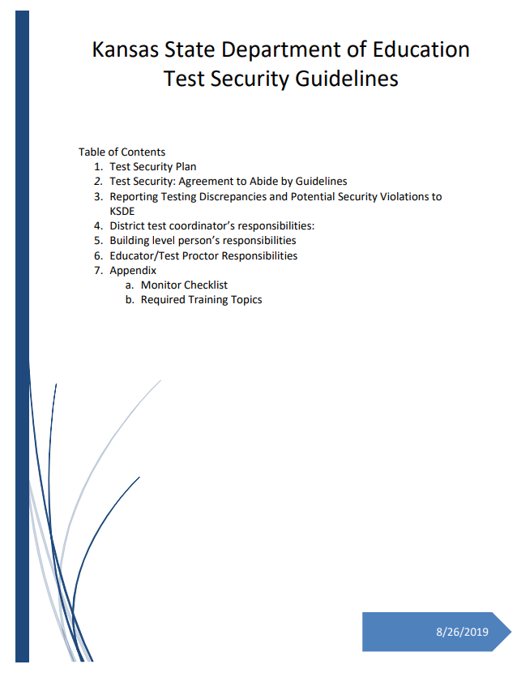
Kansas State Test Security Guidelines
Please take time now to read the Test Security Guidelines.
This training will reference key points in the document that are critical for staff who administer a state assessment to understand.
Highlight text that is important to the role you serve when administering a state assessment.
Notes:
Have staff: Highlight text that is important to the role they serve when administering a state assessment. Allow time for discussion of text in the document as you work through the training.

Slide 8
Fact Sheets
Please take time now to read the:
2019-2020 Test Security and Ethics Fact Sheet
provides an overview of the KSDE test security plan
indicates where to access the roles and responsibilities for the DTC, BTC, and test administrators in test security
tells how to report Testing Discrepancies and Potential Security Violations to KSDE
2019-2020 Appropriate Testing Practices Fact Sheet
Acceptable practices for testing
Unacceptable practices for testing
Notes:
Take time to read and review the 2018-2019 Test Security and Ethics Fact Sheet and the 2018-2019 Appropriate Testing Practices Fact sheet now. This training will refer back to these documents.

Slide 9
Purpose
Test security is essential to obtain reliable and valid scores for accountability purposes.
Accordingly, the Department of Education must take every step to assure the security and confidentiality of the state test materials.
Everyone who is involved in student testing, communicates results, and/or receives testing information is responsible for test security

Slide 10
Assessed Areas
All Kansas assessment programs must abide by test security and ethical testing practices. These programs include:
Kansas assessment summative tests in ELA, math and science
Kansas assessment predictive interim assessments in ELA and math
Kansas English Language Proficiency Assessment (KELPA)
cPass
DLM
note: additional training modules provided for staff administering DLM assessments

Slide 11
District Test Coordinators Responsibilities
This is Josh W
Oversee test security for the entire district.
Establish and implement test security and ethics procedures for the district.
Provide training for district and building-level personnel before testing begins, which includes training regarding test security procedures, ethics of testing, and reporting/documentation of accommodations. Powerpoint provided by KSDE!
KSDE Test Security Guidelines document.
Notes:
As the DTC/BTC I am responsible for test security for our district/building. Careful consideration of district practices must be put in place to ensure that test security is maintained and ethical practices are followed. I have to document which individuals have received training, when the training was provided, and the way in which the training was provided; documentation must be kept at both the district and building level. Documentation must be made available for monitor visits should our district have one. Allow staff time to ask questions about your responsibilities.

Slide 12
DTC Responsibilities:
As the DTC, Josh must maintain a training log that verifies who was trained and when the training was completed. Once you turn your verification form into your BTC, your BTC will share a completion list with the DTC (Josh).
The training log is required for a monitor visit by KSDE and for validation that staff have received training in your district.
At the end of this training, everyone will need to sign the appropriate forms to document training and agreement to abide by ethical practices and procedures.

Slide 13
Kite Educator Portal
BTCs will work with teachers/building principals to establish an assessment schedule for each individual building.
BTCs have access to the EDPortal and will provide troubleshooting if necessary.
ONLY BTCs or DTC should contact KSDE or KITE about issues or concerns that arise.
PLHS BLT – Tracey Paramore
PLMS BLT – Beth Hupe
PLES BLT – Mark Lamb

Slide 14
Kite Educator Portal
Each student will have a username and password. Teachers/proctors must emphasis to students that usernames/passwords should never be shared.
When you log into Educator Portal you will sign a Security Agreement.
Daily Access Codes:
During testing, students must use a daily access code to enter the Kite Student Portal. This code is provided in the Educator Portal and is not directly available to teachers and test proctors.
Your (BTC) Building Test Coordinator will provide the DAC (daily access code) via email on the morning of testing

Slide 15
Personal Needs Profile (PNP)
Students may have accommodations during testing. These accommodations must be done routinely and are typically part of an IEP or 504 student plan. Accommodations must be entered into the Kite Educator Portal.
BTCs (Building Test Coordinators) will work with staff to determine appropriate PNPs. Remember – accommodations must be happening regularly during instruction. We cannot provide an accommodation for the assessment that is not occurring on a regularly basis.
Your BTC will ensure that student accommodation information is entered into the Personal Needs Profile (PNP) in Educator Portal.
Keep records of documentation for text-to-speech accommodations and any other accommodation that requires a deviation from the general assessment; documentation must be kept at the district and the building level.

Slide 16
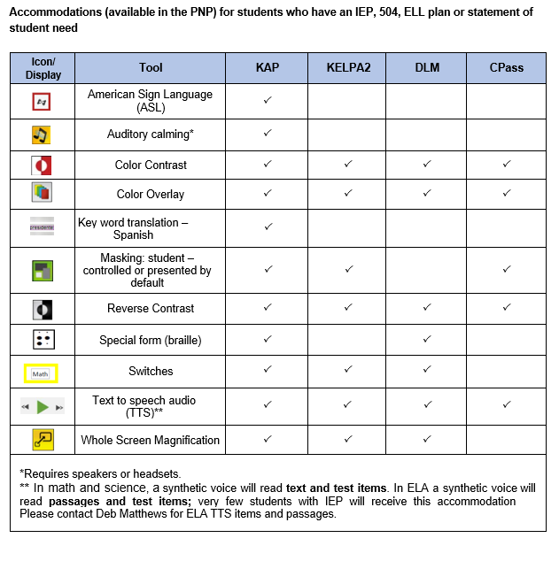
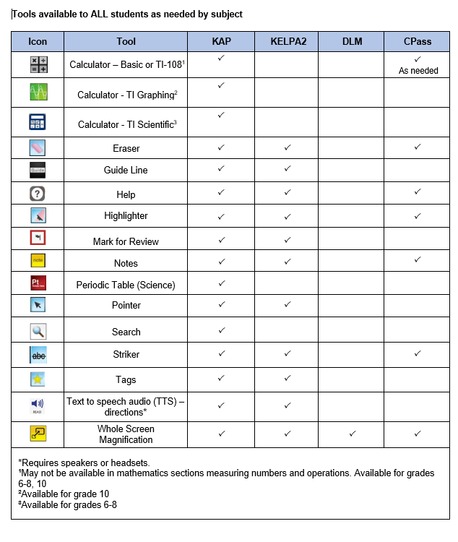
Kansas Accommodations by Program 2019-2020
An additional resource found on www.ksassessments.org and on the KSDE assessment page
Indicates the tools available for students in Kite
Let’s take a look at these tools so we are familiar with these options for students.

Slide 17
PII, Reporting
Personally Identifiable Information (PII)
Personally identifiable information (PII) is any data that could potentially identify a specific individual. Any information that can be used to distinguish one person from another and can be used for de-anonymizing anonymous data can be considered PII.
How USD 343 will report Testing Issues to Kite Service Desk
Only BTCs or the DTC will communicate issues to the state. BTC should send the student ID number, the test the students are taking (ELA, math, science, predictive interim, mini-test) and the error or concern you are reporting regarding the test taker. Any concerns or issues should be reported to your BTC immediately!
Personally identifiable information (PII) must not be conveyed when testing issues are reported.
The documentation for Kansas regarding allowable identifiers in an email specify that only the Student State ID number and no other identifying details should be provided in an email.
BTCs or the DTC will NOT include the student name, district or school via email. This is a federal violation of the Family Education Rights and Privacy Act (FERPA).

Slide 18
Reporting Testing Discrepancies and Potential Security Violations to KSDE
It is the responsibility of the BTCs, in cooperation with the DTC, to report in writing, all discrepancies in test material delivery and collection, as well as issues and concerns regarding potential violations of the Kansas State Department of Education’s test security procedures, to Lee Jones, Assessment Coordinator, Kansas State Department of Education, 785.296.4349.
AGAIN…..ONLY the BTCs or DTC should Report Testing Discrepancies and Potential Security Violations to KSDE. Any concerns or issues should be reported to your BTC immediately!

Slide 19
What happens? Reporting Testing Discrepancies and Potential Security Violations to KSDE
In consultation with staff from KSDE upon breach of security, appropriate consequences will be put in place at the district level.
Because each case is unique in nature a variety of steps could take place, but are not limited to the following suggestions:
No action taken, discussion with KSDE indicated the breach was not severe in nature to warrant any action
KSDE Action: Written letter and/or phone call to Superintendent, District Test Coordinator stating concerns and processing of action steps
Retesting of students
Removal of test proctors from testing rooms
KSDE Monitor Visit follow-up the next testing year to check for validation that changes to inappropriate practices have been made

Slide 20
Reactivations
In rare instances, some students may not be able to complete a test session.
When this happens, the test session may be reactivated by the BTC but only after an acceptable explanation from the test proctor is shared with the BTC.
Teachers should encourage and model the importance of these assessments. Statements such as “let’s get this over with” or “come on now, we have to do this whether we like it or not” should be considered inappropriate.
Encourage students to do their very bes and to show what they know!

Slide 21
Appropriate Testing Practices Acceptable Practices (Fact Sheet)
Provide students with the opportunity to learn the content and vocabulary prior to testing by basing instruction on state standards and an aligned local curriculum.
Integrate teaching of test-taking skills with regular classroom instruction and assessment.

Slide 22
Appropriate Testing Practices Acceptable Practices (Fact Sheet)
Ensure that students have had prior experience with the testing format.
Use Kite Technology Practice tests. These are for the intended purpose of practicing technology and not content.
Use formative assessments to inform instruction prior to testing. Formative tools are available in the Kite Interim system.

Slide 23
Appropriate Testing Practices Acceptable Practices (Fact Sheet)
Ensure that accommodations made on the state assessment are completed on all instructional assignments during the school year, as well as classroom, district, and standardized assessments.
Complete this training and sign an agreement to abide by KSDE Test Security, Ethics of Testing, and regulations before local testing begins.

Slide 24
Appropriate Testing Practices Acceptable Practices (Fact Sheet)
Follow test procedures outlined in the Examiner’s Manual and in the training received regarding security and ethical practices for testing.
Testing materials, student notes, scratch paper, and drawings, etc., upon completion of each test session and the entire test should be returned to your BTC. The BTC will destroy all materials.

Slide 25
Appropriate Testing Practices Acceptable Practices (Fact Sheet)
Remove or cover (with opaque material) bulletin board displays, charts and diagrams, and other instructional material that could give assistance or advantage during testing.
Monitor the testing environment actively by moving around the room; moving around the room encourages students to focus on their own work.
Verify the End Review Screen upon completion of the test to ensure that all test items have been answered before a student exits the test.

Slide 26
Appropriate Testing Practices Unacceptable Practices (Fact Sheet)
Do not store or save on computers or personal storage devices any test items; test items may not be shared via email or other file sharing systems; or reproduced by any means.
Do not review tests or analyze test items before, during, or after the assessment has been administered.

Slide 27
Appropriate Testing Practices Unacceptable Practices (Fact Sheet)
Do not discuss any specific test items on the test with students or colleagues before, during, or after the administration of the assessment.
Do not construct answer keys so that an assessment could be scored locally.
Do not use actual or altered test items (clone, parallel) for practice or instruction.

Slide 28
Appropriate Testing Practices Unacceptable Practices (Fact Sheet)
Do not conduct comprehensive reviews or drills the day of the test or between testing sessions. Once testing has begun, all reviewing should cease. Curriculum may be taught but not for review for the specific purposes of the test.
Do not require students to show work or use scratch paper; scratch paper may not be graded and must be destroyed at the end of the test session.
Do not respond to questions during testing that would help the students understand the item, aid them in responding to an item, or advise/encourage them to edit or change a response.

Slide 29
Appropriate Testing Practices Unacceptable Practices (Fact Sheet)
Do not say or do anything that would let a student know whether an answer is correct or incorrect.
Do not coach or cue students in any way during test administration, including using gestures or facial expressions for guidance.
Do not ask students the way in which they arrived at an answer.

Slide 30
Appropriate Testing Practices Unacceptable Practices (Fact Sheet)
Do not tell students to redo a specific item or to review any specific part of the test once testing has begun.
Do not go back and review each item individually with the student, simply direct students to answer items that did not have a check mark to indicate that the item was answered.

Slide 31
Monitor Visit: Purpose
KSDE staff and the members of the Kansas Assessment Advisory Council visit about 10% of Kansas schools during test administration yearly for the purpose of monitoring test security.
A representative sample of districts across Kansas will be selected. Both large and small districts from across all state BOE regions will be included.
Our BTCs (annually) do an outstanding job of preparing our staff and students for state assessments. When they ask you to complete a task, they do so per KSDE requirements, not USD 343 requirements. Please attend to and complete whatever task is requested ASAP!

Slide 32
Monitor Visits
Two methods will be used to conduct Monitor visits:
Schools/districts can volunteer to receive a monitor visit. A monitor team will be assigned to that district. The team will select the date they will conduct the visit based on the testing schedule provided by the school. The district will not be informed of the specific date selected since they have volunteered for the visit.
Unannounced visits for a random sample of schools: schools will be chosen from the list of districts/schools who did not volunteer. The district test coordinator will be alerted to potential visits and will share test schedules for the purpose of monitor visits.
Random sample collection includes consideration of Board Member districts, district size, rural/urban, previous violations, previous monitor visits.
USD 343 typically does NOT volunteer for this visit. However, we always prepare as if we will receive a visit.

Slide 33
Monitor Checklist
The monitor visit is completed by a visiting team, who will leave a copy of the report with the school as well as submit a copy to KSDE.
To view the State Monitor Quality Assurance Checklist, please click HERE.
The next three slides conclude this training. The slides include 10 quick quiz questions that will allow you to double check your understanding of the Test Security and Ethics guidelines established by KSDE! Have a scratch pad handy to record your answers. Correct answers are provided after question 10.
Once you finish your training, please be sure to sign the Agreement to Abide by Guidelines document found HERE (on the USD343 assessment page). Give to your BTC (Building Test Coordinator). It is always a great idea to save a PDF copy of the “agreement to abide” document.

Slide 34
Kansas State Test Security and Ethics Quick Check of Understanding!
True or False | Read each statement and decide if it is true or false.
1. | When you complete the training module you must sign a verification of training and agreement to abide by ethics and test security policies and practices.
2. | If you notice a student didn’t answer a question correctly it is okay to tell them to check their work.
3. | As a test proctor students should raise their hand and indicate they are finished before exiting the test. It is okay to review the end review screen to make sure students have answered all items on the test.

Slide 35
Kansas State Test Security and Ethics Quick Check
True or False | Read each statement and decide if it is true or false.
4. | A monitor visit allows KSDE to see the good things that schools are doing to ensure test security and ethical practices are maintained.
5. | When reporting an item issue on the test it is okay to take a picture of the item and send to KSDE.
6. | During administration of the math assessment students may use handheld calculators. If handheld calculators are used teachers must actively monitor this use. Before and after the test session calculators must be cleared.

Slide 36
Kansas State Test Security and Ethics Quick Check
True or False | Read each statement and decide if it is true or false.
7. | Actively monitoring the testing sessions by test proctors is critical to maintaining security.
8. | Parents may help administer the state assessment.
9. | Accommodations on the state assessment must be part of regular classroom practice.
10. | The monitor team observed a test proctor reading the assessment from the screen to a student. This is an acceptable practice.

Slide 37
Kansas State Test Security and Ethics Quick Check - KEY
True
False – you may not tell students to redo or review a specific item.
True
True
False – Report only the student id, test being taken, session number and item number and the issue with the item.
True
True
False – Parents may not administer the assessment.
True
False – you may not read questions or passages from the screen.

Slide 38
Questions?
PLHS BTC – Tracey Paramore
PLMS BTC – Beth Hupe
PLES BTC – Mark Lamb
DTC – Josh Woodward
Don’t forget to print, sign your Agreement to Abide document, then immediately submit to your BTC. DEADLINE is Feb 28!

